Slide 1

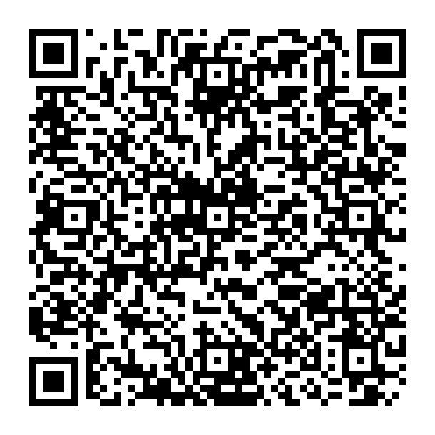
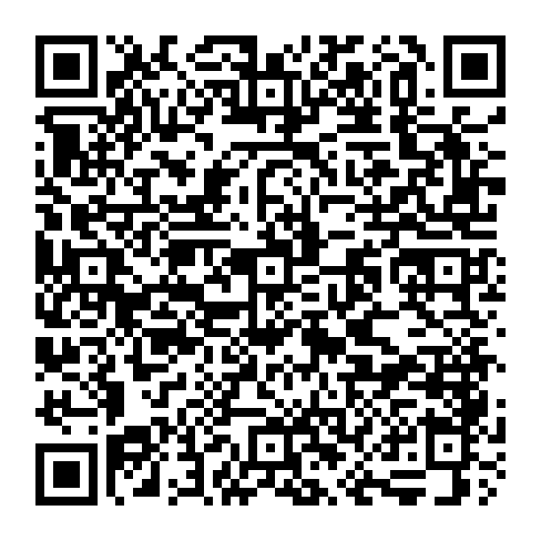




Powering the Future of AI:
Semiconductor Science & Technology
A new Accelerated Master’s Program (AMP)
A new Master of Science in Physics emphasis
Master core semiconductor manufacturing skills
Explore emerging semiconductor technologies
AMP
BS & MS degrees
In five years
1-2Y
Flexible Regular
Master Program
4+1
Semiconductor Physics
Quantum Mat. & Dev.
FASTLab
Semiconductor Processing
Advanced Device Fab & Test
and more…
Program highlights
Inaugural Fall 2026 Cohort – Special Incentives
Tuition Scholarships & Fellowships
Paid Instructional Assistant Positions ($500–$1,000/month)
Application Fee Waivers
LOR Waived (Qualified Applicants)
Open to students majoring in Physics, ECE, and MSE or other closely related disciplines who want to accelerate their path into the semiconductor industry
MS
AMP
More information : debuhrc@arizona.edu

